Slide 1
GRAPH AND DIAGRAM
LECTURE # 4

Slide 2

Introduction
 One of the most convincing and appealing ways in which statistical results may be presented is through diagrams and graphs.
 Just one diagram is enough to represent a given data more effectively than thousand words.
 It easy to understand diagrams even for ordinary people.

Slide 3
A. Histogram
A histogram is a bar chart or graph showing the frequency of occurrence of each value of the variable being analyzed.
In histogram, data are plotted as a series of rectangles. Class intervals are shown on the ‘X-axis’ and the frequencies on the ‘Y-axis’ .
The height of each rectangle represents the frequency of the class interval. Each rectangle is formed with the other so as to give a continuous picture. Such a graph is also called staircase or block diagram.
we cannot construct a histogram for distribution with open- end classes. It is also quite misleading if the distribution has unequal intervals and suitable adjustments in frequencies are not made.

Slide 4
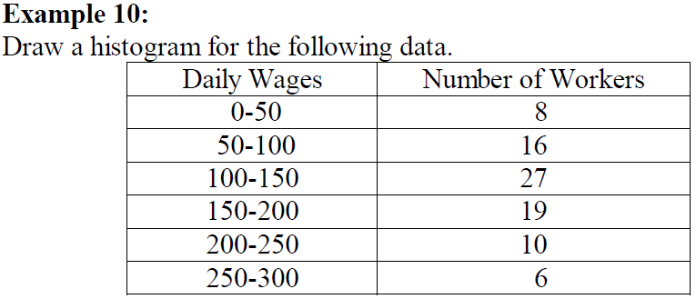
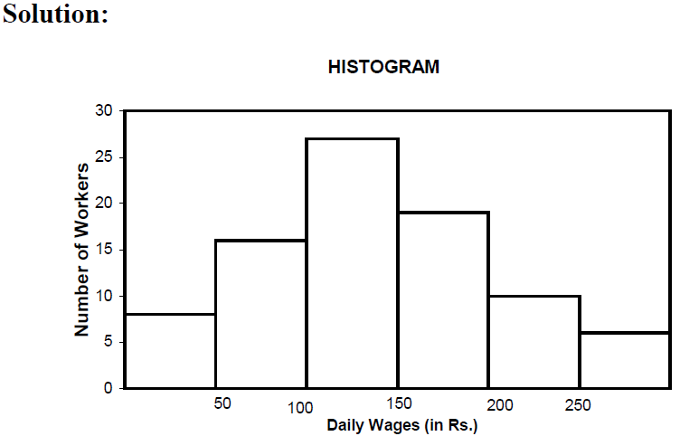

Slide 5

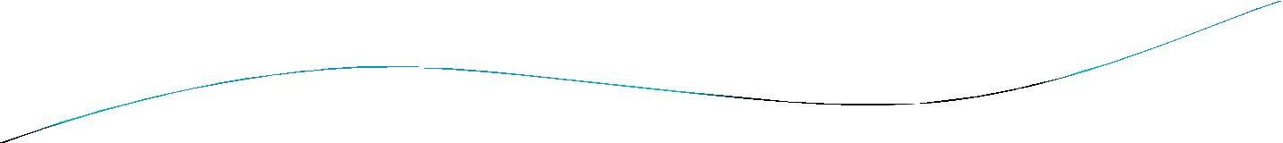


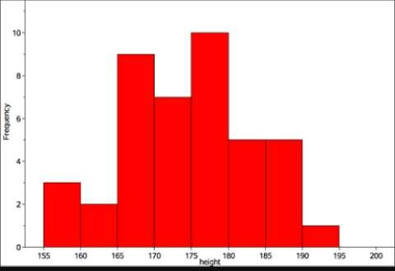
Histogram for equal class width:
Class Interval (Height in cm) | Freq .
155-160 | 3
160-165 | 2
165-170 | 9
170-175 | 7
175-180 | 10
180-185 | 5
185-190 | 5
190-195 | 1

Slide 6

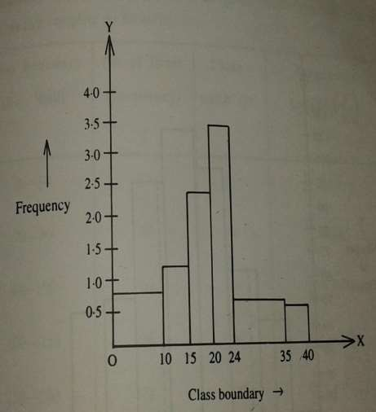
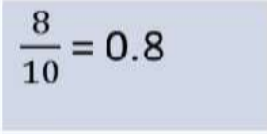
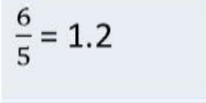
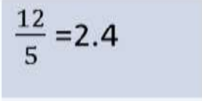
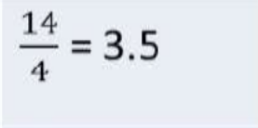
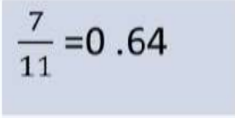
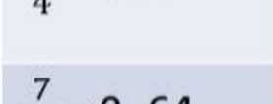
Histogram for unequal class width:
Class bound ary | Fre que ncy | Class Widt h | Frequency Density
0-10 | 8 | 10
10-15 | 6 | 5
15-20 | 12 | 5
20-24 | 14 | 4
24-35 | 7 | 11
35-40 | 3 | 5

Slide 7
B. Frequency Polygon
If we mark the midpoints of the top horizontal sides of the rectangles in a histogram and join them by a straight line, the figure so formed is called a Frequency Polygon.
This is done under the assumption that the frequencies in a class interval are evenly distributed throughout the class.
The area of the polygon is equal to the area of the histogram, because the area left outside is just equal to the area included in it.

Slide 8

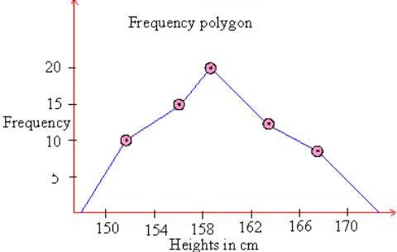
How to draw frequency polygon?
Height in Cm (class interval) | Mid value | frequen cy
150-154 | 152 | 10
154-158 | 156 | 15
158-162 | 160 | 20
162-166 | 164 | 12
166-170 | 168 | 8

Slide 9
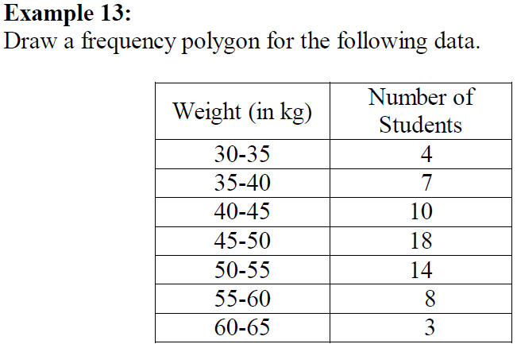
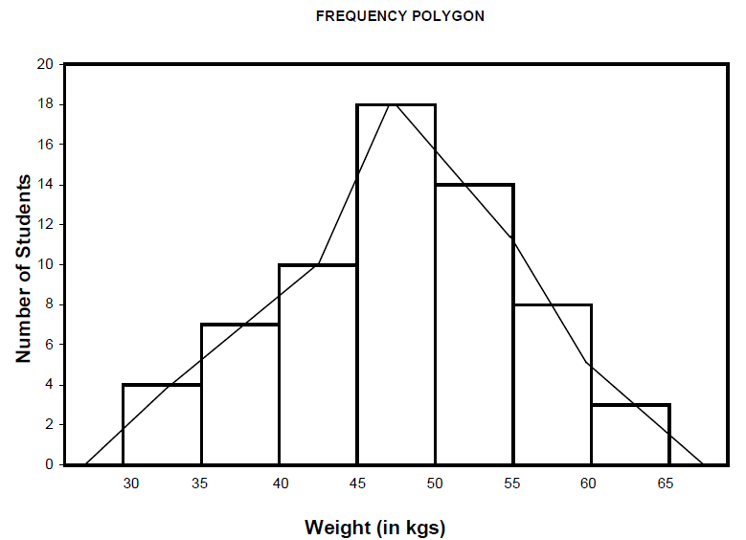

Slide 10

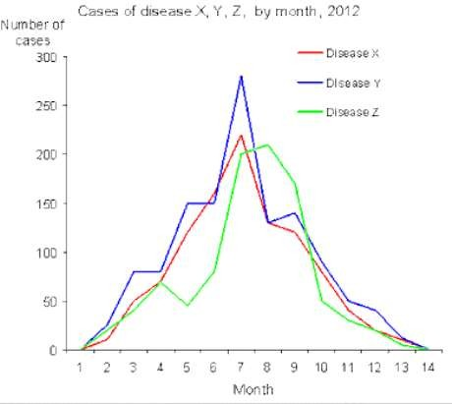
Two or more groups can be compared through Frequency Polygon

Slide 11
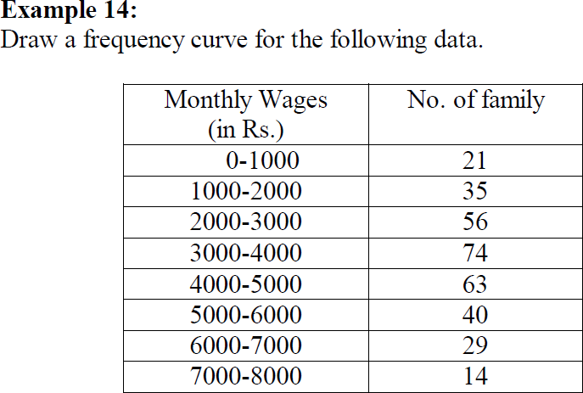
C. Frequency Curve
If the middle point of the upper boundaries of the rectangles of a histogram is corrected by a smooth freehand curve, then that diagram is called frequency curve.
The curve should begin and end at the base line.

Slide 12

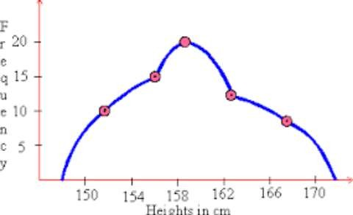
FREQUENCY POLYGON
V/S
FREQUENCY CURVE

Slide 13
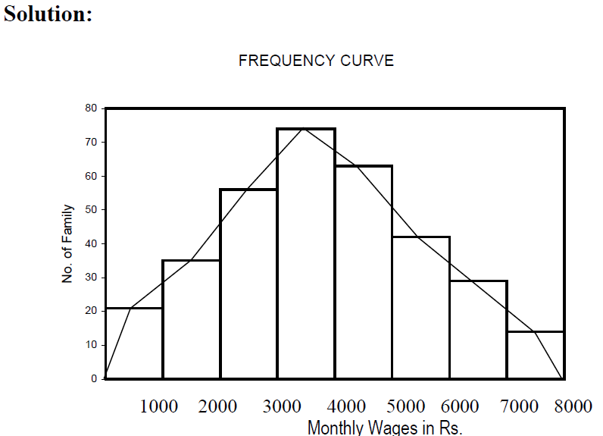

Slide 14
D. Ogives
For a set of observations, we know how to construct a frequency distribution. In some cases we may require the number of observations less than a given value or more than a given value.
This is obtained
by a accumulating (adding) the frequencies upto (or above) the give value. This
accumulated frequency is called cumulative frequency.
These cumulative frequencies are then listed in a table is called cumulative frequency table. The curve table is obtained by plotting cumulative frequencies is called a cumulative frequency curve or an ogive.

Slide 15








Ogive
The ‘ less than ogive’ method
The ‘more than ogive’ method.

Slide 16
In less than ogive method we start with the upper limits of the classes and go adding the frequencies. When these frequencies are plotted, we get a rising curve.
In more than ogive method, we start with the lower limits of the classes and from the total frequencies we subtract the frequency of each class. When these frequencies are plotted we get a declining curve.

Slide 17
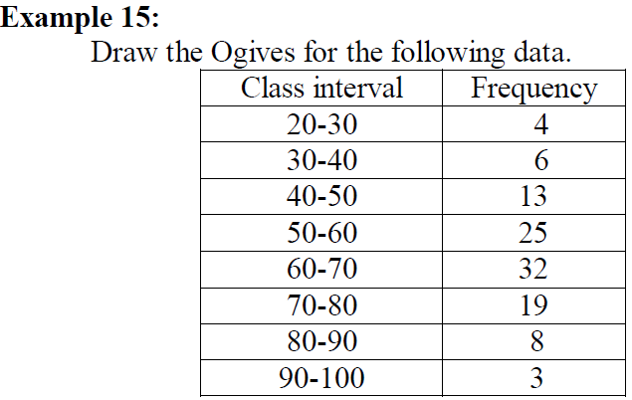

Slide 18
Class limit | Less than ogive | More than ogive
20 | 0 | 110
30 | 4 | 106
40 | 10 | 100
50 | 23 | 87
60 | 48 | 62
70 | 80 | 30
80 | 99 | 11
90 | 107 | 3
100 | 110 | 0

Slide 19
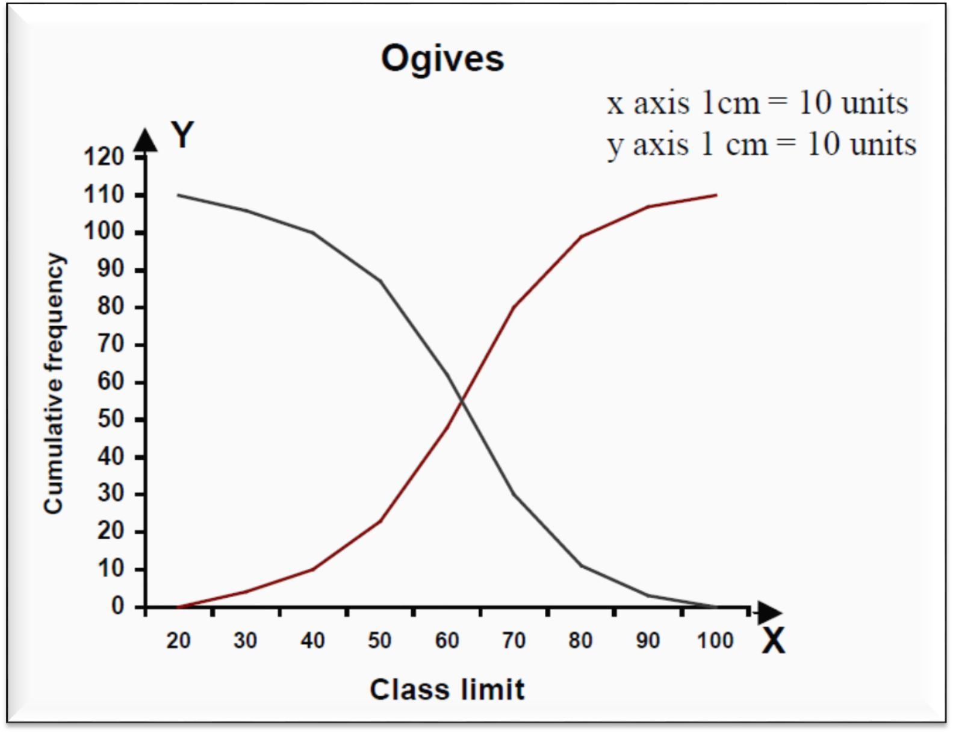

Slide 20
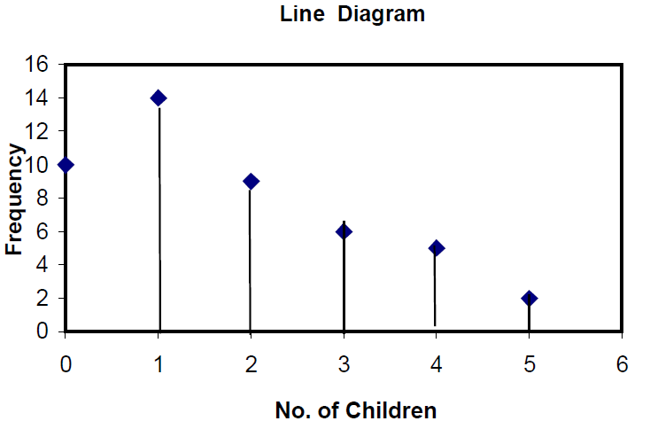
Line Diagram
Line diagram is used in case where there are many items to be shown and there is not much of difference in their values.
Such diagram is prepared by drawing a vertical line for each item according to the scale.
The distance between lines is kept uniform.
Line diagram makes comparison easy, but it is less attractive.

Slide 21

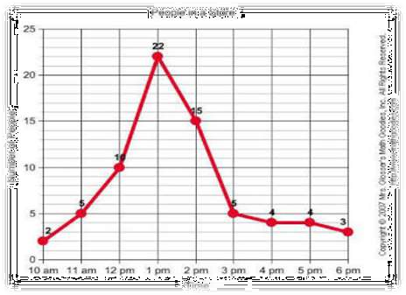
Line graph:
line graphs are simple Mathematical graphs that are drawn on the
graph paper by plotting the data connecting one variable on the horizontal X- axis and other variable of data on the vertical Y-axis.
EXAMPLE:
Time | 10 am | 11 am | 12 pm | 1 pm | 2 pm | 3 pm | 4 pm | 5 pm | 6 pm
No of People | 2 | 6 | 10 | 22 | 15 | 5 | 4 | 4 | 3

Slide 22

Simple Bar Diagram
Simple bar diagram can be drawn either on horizontal or vertical base.
Bars must be uniform width and intervening space between bars must be equal.
While constructing a simple bar diagram, the scale is
determined on the basis of the highest value in the series.
To make the diagram attractive, the bars can be coloured.
Bar diagram are used in business and economics.

Slide 23
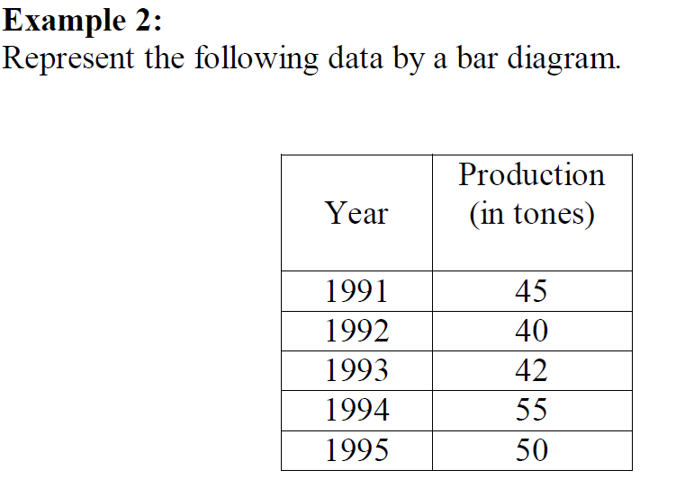
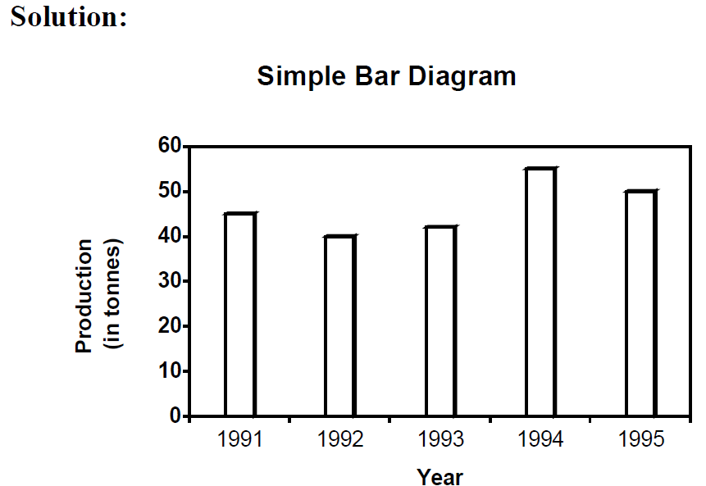
Simple Bar Diagram (Cont)
However, an important limitation of such diagrams is that they can present only one classification or one category of data.
For example, while presenting the population for the last five decades, one can only depict the total population in the simple bar diagrams, and not its sex-wise distribution.

Slide 24

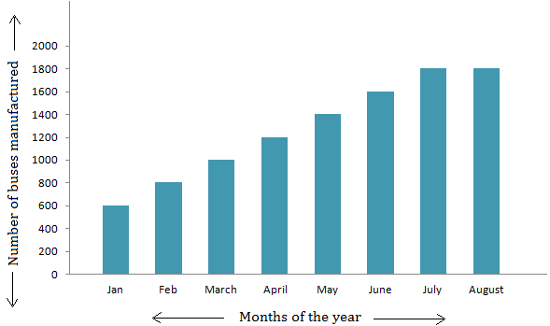
Months | Jan | Feb | Mar | Apr | May | June | Jul | Aug
No. of buses manufacture d | 600 | 800 | 1000 | 1200 | 1400 | 1600 | 1800 | 1800

Slide 25
Multiple Bar Diagram
Multiple bar diagram is used for comparing two or more sets of statistical data.
Bars are constructed side by side to represent the set of values for comparison.
In order to distinguish bars, they may be either differently coloured or there should be different types of crossings or dotting, etc.
An index is also prepared to identify the meaning of different colours or dottings.

Slide 26
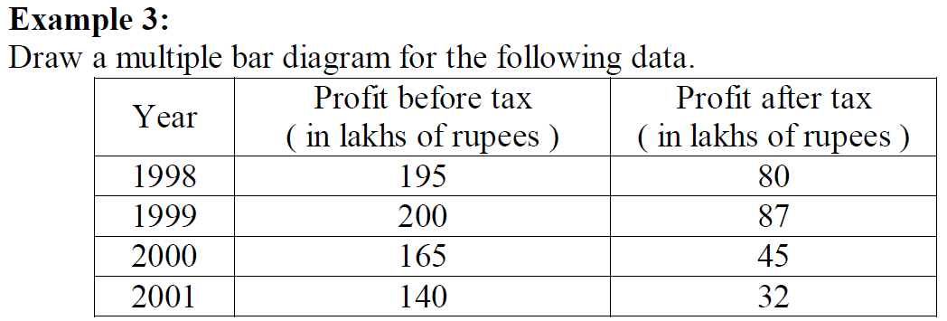
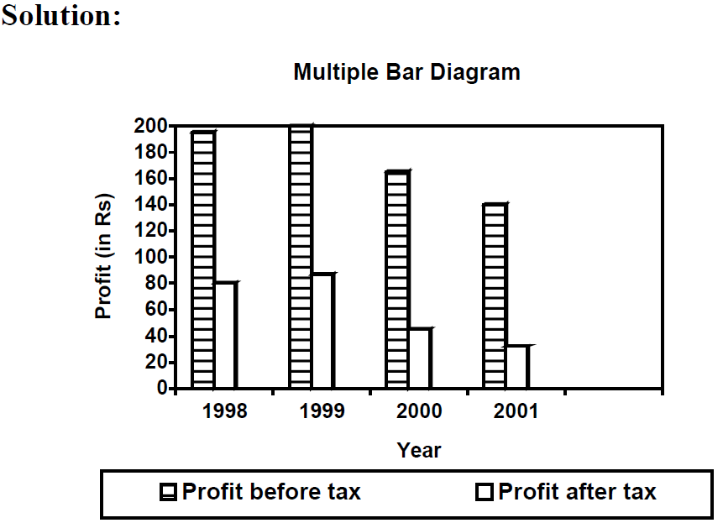

Slide 27
Sub-divided Bar Diagram
In a sub-divided bar diagram, the bar is sub-divided into various parts in proportion to the values given in the data and the whole bar represent the total.
Such diagrams are also called Component Bar diagrams.
The sub divisions are distinguished by different colors or crossings or dotting.
The main defect of such a diagram is that all the parts do not have a common base to enable one to compare accurately the various components of the data.

Slide 28
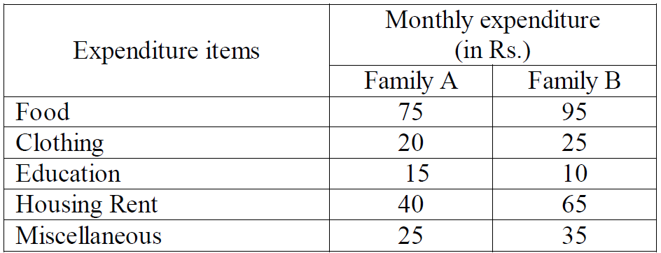
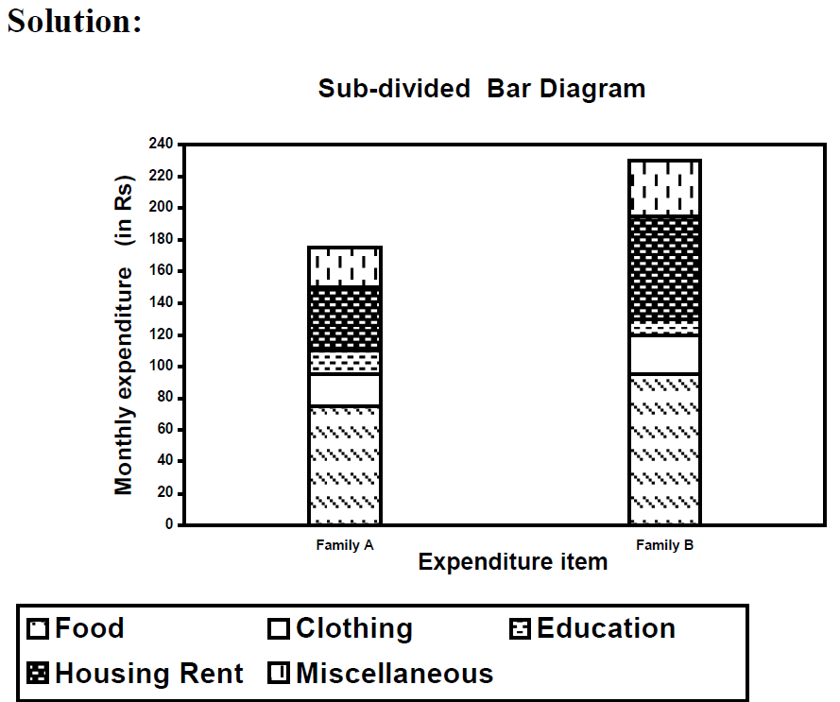
Example 4 Represent the following data by a sub- divided bar diagram.

Slide 29
Percentage Bar Diagram
The components are not the actual values but percentages of the whole.
The main difference between the sub-divided bar diagram and percentage bar diagram is that in the former the bars are of different heights since their totals may be different whereas in the latter the bars are of equal height since each bar represents 100 percent.
In the case of data having sub-division, percentage bar diagram will be more appealing than sub-divided bar diagram.

Slide 30
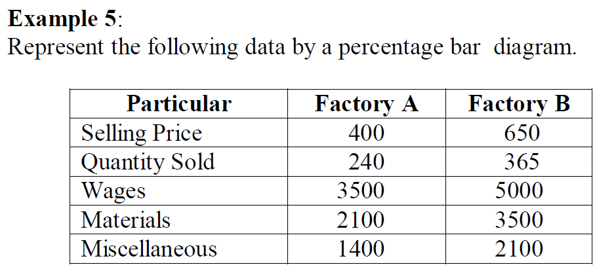
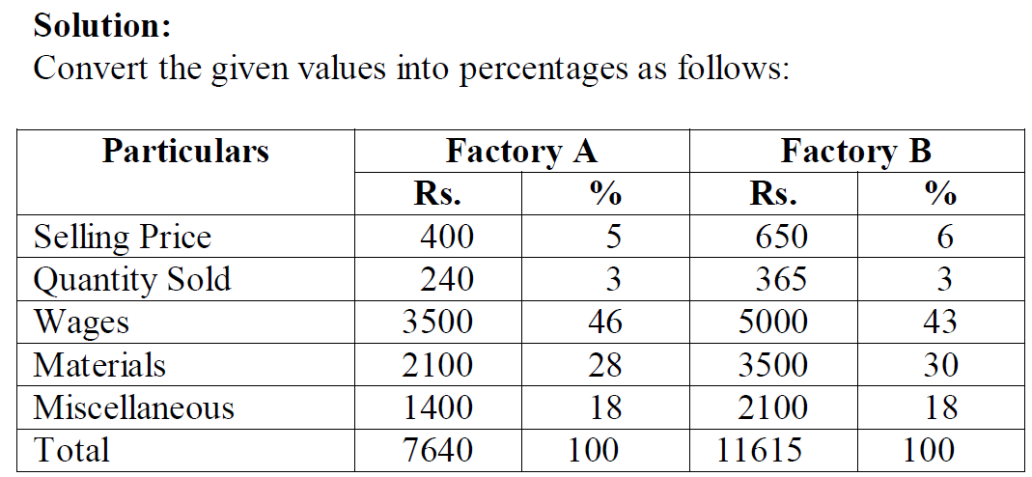

Slide 31
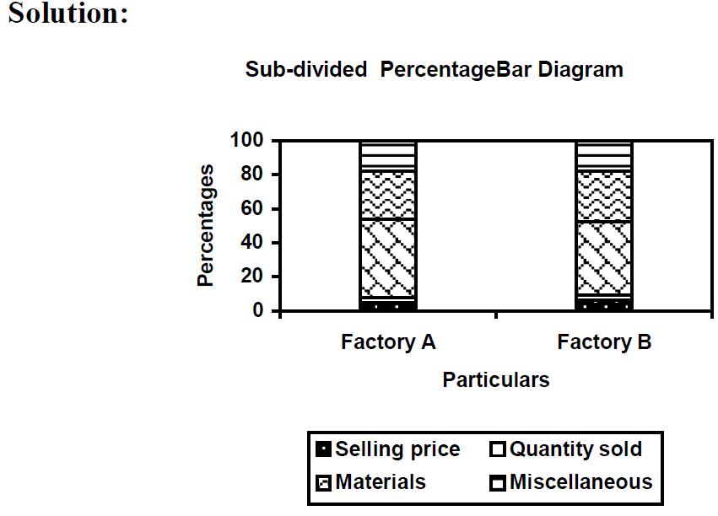

Slide 32









In two-dimensional diagrams the area represent the data and so the length and breadth have both to be taken into account.
Such diagrams are also called area diagrams or surface diagrams.
The important types of area diagrams are:
Rectangles.
Squares.
Pie-diagrams

Slide 33
Rectangles
Rectangles are used to represent the relative magnitude of two or more values.
The area of the rectangles are kept in proportion to the values.
Rectangles are placed side by side for comparison.
We may represent the figures as they are given or may convert them to percentages and then subdivide the length into various components.

Slide 34
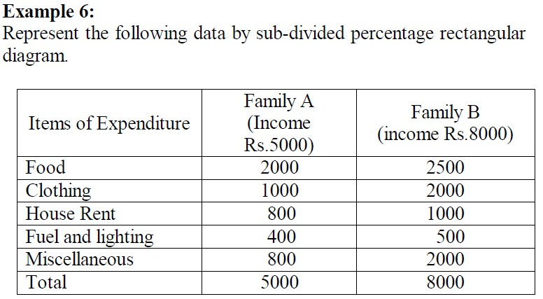
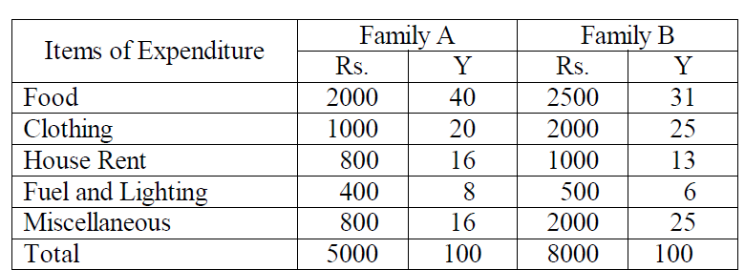
Solution: The items of expenditure will be converted into percentage as shown below

Slide 35
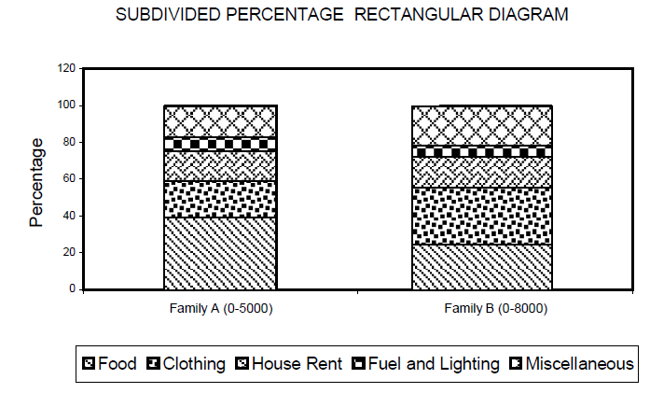

Slide 36
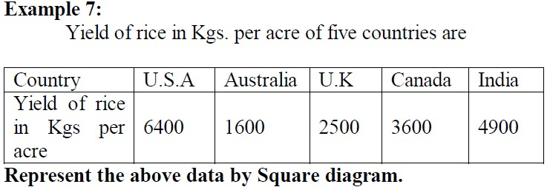
Squares
The rectangular method of diagrammatic presentation is difficult to use where the values of items vary widely.
The method of drawing a square diagram is very simple.
One has to take the square root of the values of various item that are to be shown in the diagrams and then select a suitable scale to draw the squares.

Slide 37
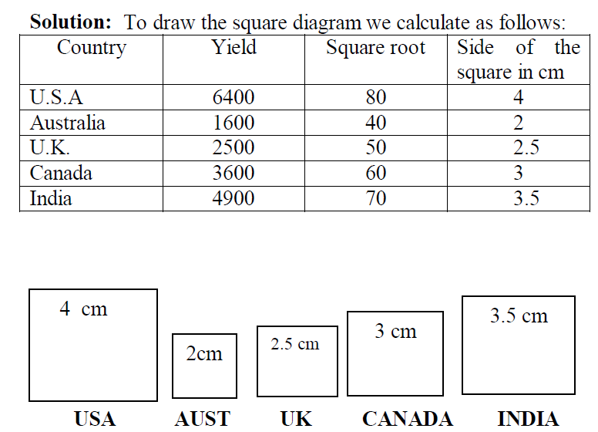

Slide 38
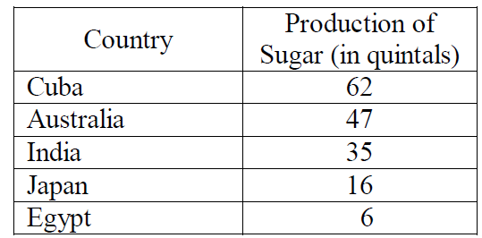
Pie Diagram or Circular Diagram
In such diagrams, both the total and the component parts or sectors can be shown. The area of a circle is proportional to the square of its radius.
While making comparisons, pie diagrams should be used on a percentage basis and not on an absolute basis.
Example 8: Draw a Pie diagram for the following data of production of sugar in quintals of various countries.

Slide 39
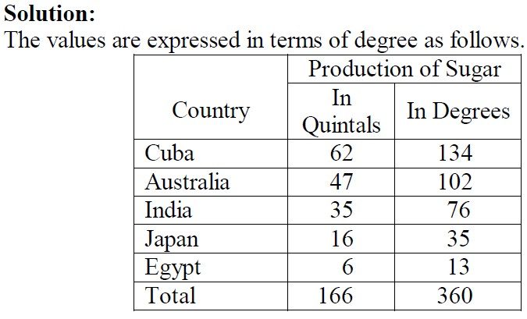
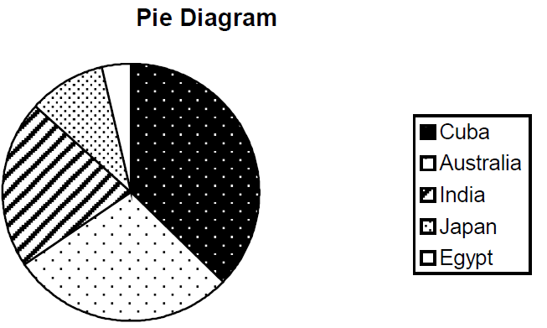

Slide 40

EXAMPLE:
(Table: the result of class 10 of a school)
Marks Division | First | Second | Third | Failures
% of student | 20% | 56% | 20% | 4%

Slide 41
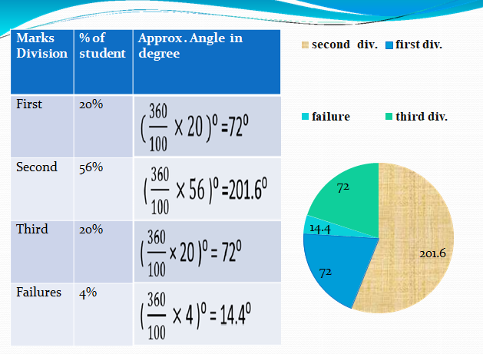
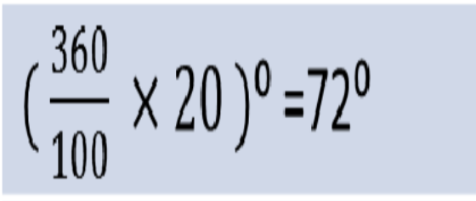
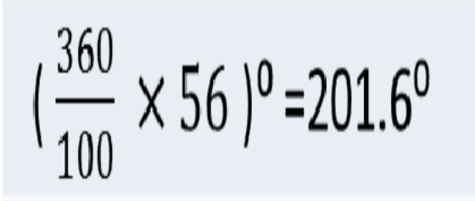
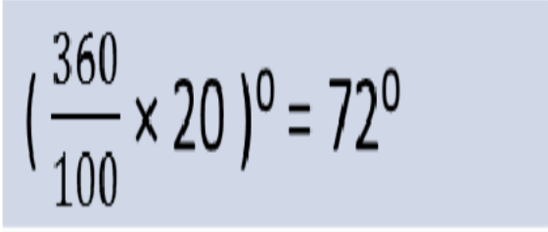
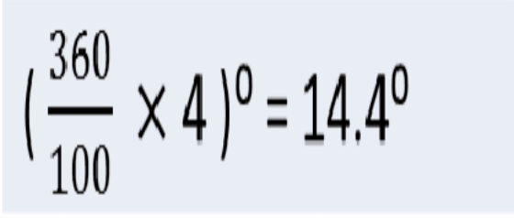
second div.
Marks Division | % of student | Approx . Angle in degree
First | 20%
Second | 56%
Third | 20%
Failures | 4%
first div.
failure
third div.
72
14.4
201.6
72

